Slide 1
Why do we need Rules of Inference?
Can a machine take decisions?
Lecture 3 extended
3rd February,2017

Slide 2
When there are many premises would we use truth table?
Premise#1 Premise#2 ... Premise#n Conclusion
An argument is valid if the truth of all its premises implies that the conclusion is true.
p1, p2, . . . , pn and conclusion q is valid, when (p1 ∧ p2 ∧ · · · ∧ pn) → q is a tautology.
What is tautology?

Slide 3
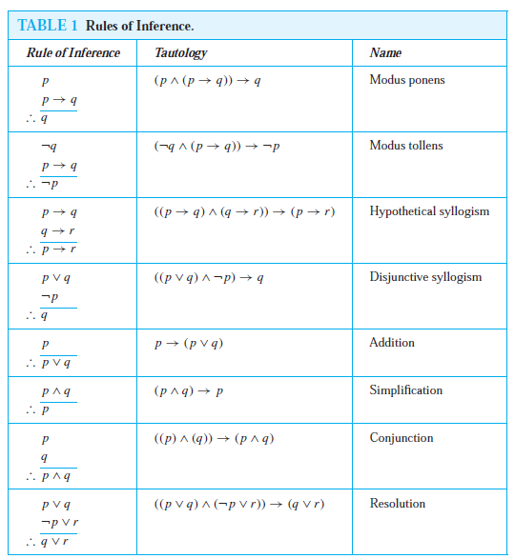

Slide 4
Example
We would like to determine whether this is a valid argument. That is, we would like to determine whether the conclusion “You can log onto the network” must be true when the premises “If you have a current password, then you can log onto the network” and “You have a current password” are both true.

Slide 5

Can you check it using truth table?
p= “You have a current password” and q =“You can log onto the network.”
Then, the argument has the form
The statement ((p → q) ∧ p) → q is a tautology.

Slide 6
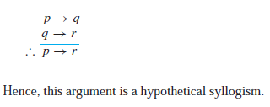
What would be the result?
Let p be the proposition “It is raining today,” let q be the proposition “We will not have a barbecue today,” and let r be the proposition “We will have a barbecue tomorrow.”
Then this argument is of the form

Slide 7
CONVERSE, CONTRAPOSITIVE, AND INVERSE
We can form some new conditional statements starting with a conditional statement p → q.
In particular, there are three related conditional statements that occur so often that they have special names.
The proposition q → p is called the converse of p → q.
The contrapositive of p → q is the proposition ￢q →￢p.
The proposition ￢p →￢q is called the inverse of p → q.
We will see that of these three conditional statements formed from p → q, only the contrapositive always has the same truth value as p → q.

Slide 8
Task-1
What are the contra-positive, the converse, and the inverse of the conditional statement “The home team wins whenever it is raining.”

Slide 9
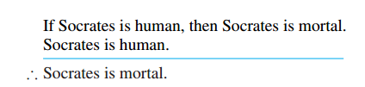
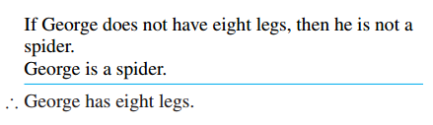
Find the argument form for the following argument and determine whether it is valid. Can we conclude that the conclusion is true if the premises are true?
Task-2

Slide 10
Task 3
“If you send me an e-mail message, then I will finish writing the program,” “If you do not send me an e-mail message, then I will go to sleep early,” and “If I go to sleep early, then I will wake up feeling refreshed” lead to the conclusion “If I do not finish writing the program, then I will wake up feeling refreshed.

Slide 11
Task 4
“It is not sunny this afternoon and it is colder than yesterday,” “We will go swimming only if it is sunny,” “If we do not go swimming, then we will take a canoe trip,” and “If we take a canoe trip, then we will be home by sunset” lead to the conclusion “We will be home by sunset.

